Slide 1
Concurrency With Akka Actors
- Jyotirmay Mishra

Slide 2
Outline
Various Concurrency Models
Actor System and its History
Akka Introduction
Akka Actors
Akka Actors Core Operations
Other Features of Akka
Demo
Summary of Akka
Use Cases
Case Study – EPS Application

Slide 3
Various Concurrency Models
Threads and Locks
Default choice for concurrency
Functional Programming
Immutability does the job
Actors
State is mutable within the actor and not shared
Distributed and fault tolerant
Communicating Sequential Processes(CSP)
Quite similar to actor model
Channels are used for communications

Slide 4
Actor System
Carl Hewitt on Actors
Actor - Fundamental unit of computation, a computation model - not just a form of concurrency
An Actor has three essential elements:
Processing - you have to get something done
Storage - you have to be able to remember things
Communication
Axioms - When an Actor receives a message what can it do:
Create more Actors
Send messages to other Actors that it has addresses for
Designate how the Actor is going to handle the next message it receives

Slide 5
Akka
The name comes from the goddess in the Sami (Native swedes) mythology that represents all the wisdom and beauty in the world.
What is Akka?
Akka is a toolkit and runtime for building highly concurrent, distributed, and fault tolerant event/message-driven applications on the JVM.

Slide 6
Akka-Actors
Lightweight objects
Consist of State, behavior, mailbox and supervisor strategy
No shared state
Communicate using message passing
Part of Supervision Hierarchy
Originally implemented in Erlang
Distributed by design
In different scenarios, Actor can be : A thread, An object, A callback or listener, A Singleton or Service, A Router or Load Balancer or Pool, A Message Driven Bean and much more.

Slide 7
4 Core Operations of Actors
0. Define
Create
Send
Become
Supervise

Slide 8
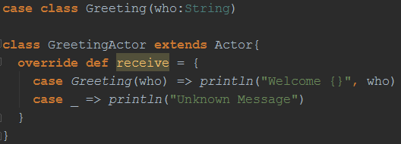
0. Define
Define Message to handle by Actor
Define Actor Class

Slide 9
1. Create
Create an Actor System

Slide 10
1. Create
CREATE – creates a new instance of Actor
On actor creation, you get ActorRef insteadOf actor object.
Actors are extremely lightweight (2.7 Million in 1 GB)
Very strong encapsulation – encapsulates:
State
Behavior
Message queue
Only way to observe/update state is by sending a message to that actor

Slide 11

2. Send
Send a message to Actor
Asynchronous and Non-Blocking
Everything happens reactively
Actor is passive until a message arrives
Messages are kinetic energy of Actor system
Actor can have lots of buffered potential energy but require a message to trigger
Another form of sending message is Ask or ?
It returns a Future which is Also Asynchronous and non-blocking

Slide 12
3. Become
BECOME – dynamically redefines actor behavior
Trigger reactively upon receiving a message
React differently to messages after become
Behavior are stacked, can be pushed and poped
Benefits:
Actor can adaptively transform to Actor Pool or Router
Implement an FSM
Implement graceful degradation

Slide 13
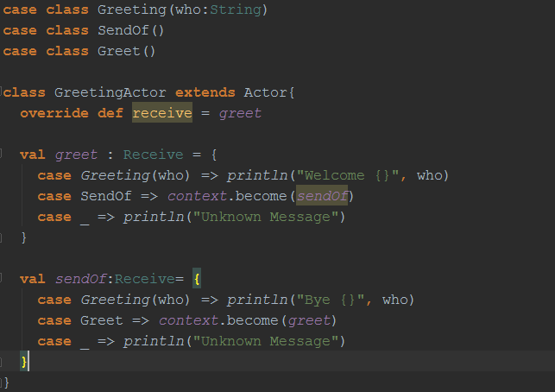
3. Become

Slide 14
Failure Management Earlier
You spawn a new thread for concurrency
If that thread fails then no way to know as error do not propagate to other threads
You need to do all the error handling explicitly with business logic
Your code gets TANGLED with business logic, thread and error handling.
WE CAN DO BETTER THAN THIS.

Slide 15
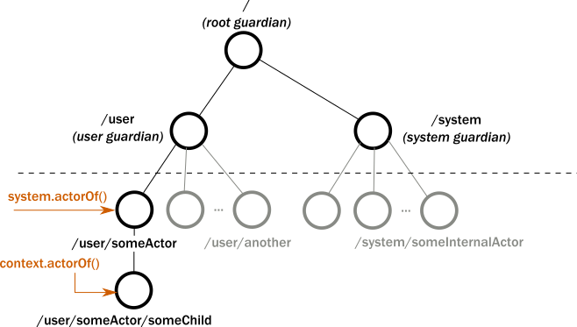
Actor Hierarchy
An actor always belongs to a parent
All actor created programmatically have a common parent, the User Guardian

Slide 16
4. Supervise
SUPERVISE – manage another actor failures
Akka works “Let it crash” methodology
Error handling in Actor is by letting other Actor handle your failures.
If an Actor crashes, notification is sent to supervisor, who can react upon the failure
This provides clean separation of error handling and business logic.

Slide 17
Other Features of Akka ToolKit
Akka Clustering
Akka Remoting
Akka-HTTP
Akka Streams

Slide 18
DEMO

Slide 19
Akka – Program at higher level
Never think about (Low level concurrency is simpler)
Shared state
Threads
Locks
Think about
message flows
What you get :
High CPU utilization
Low latency and High throughput
Scalability

Slide 20
Akka – Distributable by Design
Everything in Akka is distributed by default
Going from local to remote by configuration
Perfect Programming Model for the Cloud
Elastic & dynamic
Fault-tolerant & self-healing
Load-Balancing & cluster rebalancing
Loosely coupled and dynamic systems that can change and adapt at runtime

Slide 21
Akka – Use Cases
Transaction processing (online gaming, finance, statistics, betting, social media, telecom, ...)
scale up, scale out, fault-tolerance / HA
Service backend (any industry, any app)
service REST, SOAP, cometd etc
Play framework built on top of Akka-Http
LinkedIn RealTime-Presence plateform
Twitter, Samsung, MiddleGate, Credit Karma, Norwegian Cruirse

Slide 22
Case Study - EPS
Use Case : Publish agent event changes from inContact to partners in Real-Time
Technologies :
Akka Toolkit
Kinesis
WebSocket
We build a system consisting of following actors :
Kinesis Consumer Actor Director Actor
Transformer Actor WebSocket Actor
Router Actor Health-Check Actor

Slide 23
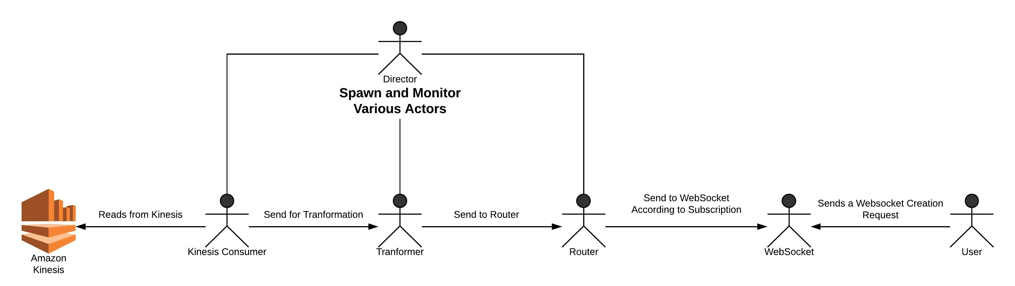
Case Study - EPS

Slide 24
Case Study – EPS - Results
ENV Config | Value
Microservice location | AWS Region - us-west-1
Microservice VM size | t2.micro
Subscriber Location | Pune lab
Number of events | 15000
ENV Config |  | Metrics | Value
Microservice location | AWS Region - us-west-1 | Time taken by Kinesis stream | 380 ms
Microservice VM size | t2.micro | Time spent in the microservice | 8 ms
Subscriber Location | Pune lab | Time spent from MS to the subscriber | 160 ms
Number of events | 15000 | Average time for event from VC to Subscriber | ~548 ms

Slide 25
Thank You.

